Slide 1
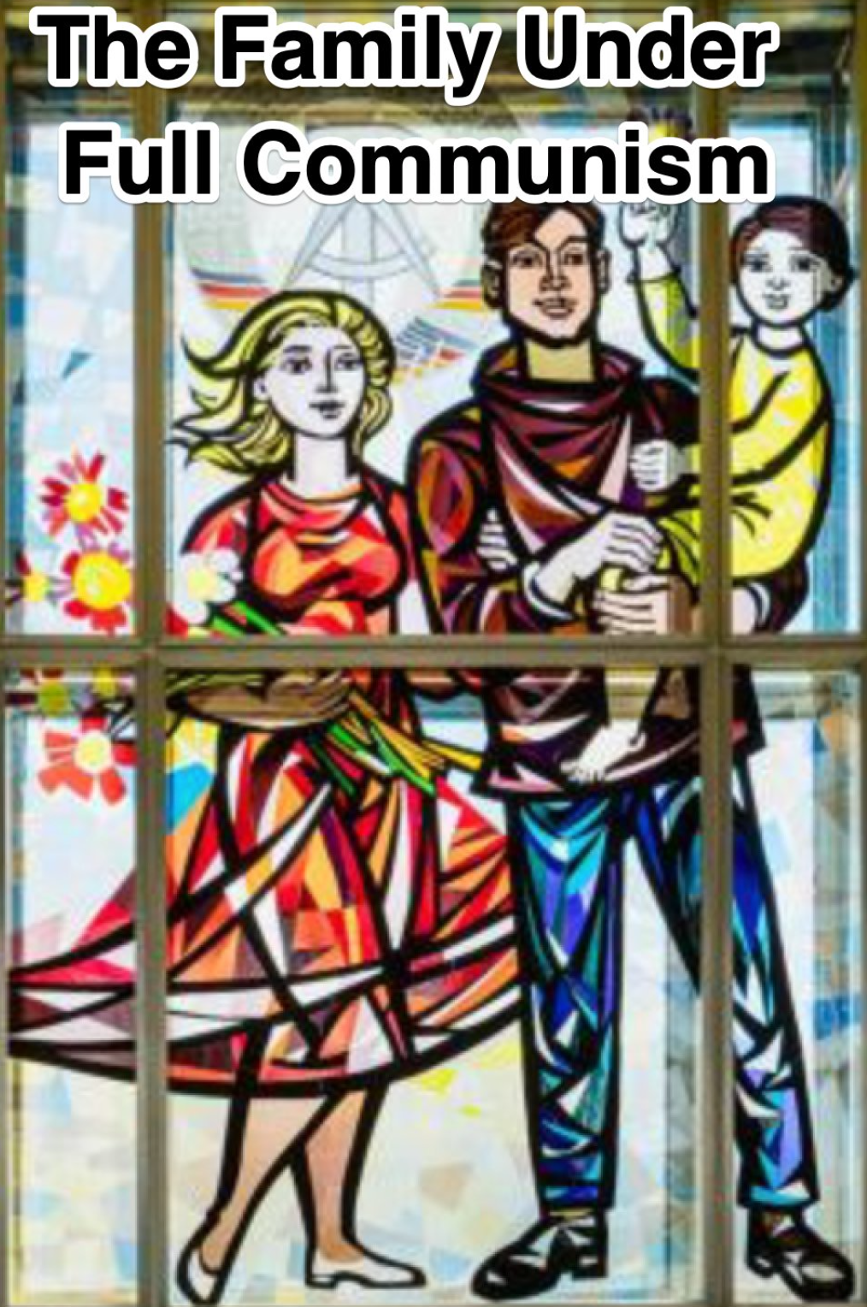

Lecture: Alternatives to the ‘Classical Liberal’ Order: Really-Existing Socialism
The Great Depression broke the “classical liberal” “laissez-faire” order:
All thought that the world should get back to 1870-1913—or what people imagined what 1870-1913 had been like—was now a non-starter
What would replace that order? Three possibilities:
On the right, some form of fascism…
In the center, somehow shore up the system…
On the left, some form of “socialism”
Let’s look at socialism first…
And let’s look at really-existing socialism
For there was no worked-out blueprint for what socialism should be that Lenin had in the back of his file cabinet…
3:30 of audio in this slide; 20:45 in this slide group
Notes:
In the midst of the Great Depression, it seemed pretty clear to almost all that the existing global economic and the national political-economic orders had failed: failed to restore the rapid upward march of prosperity, failed to provide a land fit for heroes to live in, failed to generate stable high unemployment, failed to vindicate citizens’ Polanyian rights—to a secure place in a stable community, to confidence that your job or at least the ability to find a new and better or as-good job easily would be there, to incomes that corresponded to what you deserve—and they had even failed to provide the rights that a market society is supposed to focus on: that ownership of property gives you security, prosperity, and power.
The coming of the Great Depression had demonstrated that property rights are only worth much in a well-functioning economy. Political insurgencies had demonstrated that property rights themselves could be up for grabs. And the coming of truly mass politics—reinforced by those new modes of social media, the radio, the really cheap flyer, and the gutter press—had shown elites that patterns of deference, authority, respect, and the formation of societal consensus were up for grabs as well. The old system did not work.
But if markets doing the economizing and if representative elected parliamentary assemblies doing the governing manifestly did not do the job, what were the alternatives. Were there alternatives? There were: really-existing socialism, on the left, and fascism, on the right hand.
I write “really existing socialism” rather “Marxism” or “communism” because the movement had, by 1930, transformed itself from a river to a delta. We can at least point to what really-existing socialism was: the régimes that ruled the Soviet Union from its creation to destruction, that ruled the occupied Soviet satellites of Eastern Europe after World War II, post-Chiang Kaishek pre-Deng Xiaoping China, Cuba after 1959, and North Korea after 1945. Other words were and are all up for grabs.
In Western Europe and North America after and indeed before World War I, most who called themselves any flavor of“socialist” held that in a good society there ought to be enormous scope for individual initiative, for diversity, for the decentralization of decision making, for liberal values, and for private property. In price regulation and in public ownership. the question was an empirical one: private where private belongs, public where it was needed, with circumstances altering cases. And most trusted representative democracy and rational argument could be trusted to settle things case-by-case. But there were those who were less meliorist, and more radical. They wanted an alternative to even a reformed, well-managed, and kinder and gentler market economy. But what this alternative was was not clear to Marx and Engels or, indeed, to any of their pre-Lenin successors. It was only when Lenin began to try to exercise power that people would find out what really existing socialism would become.

Slide 2
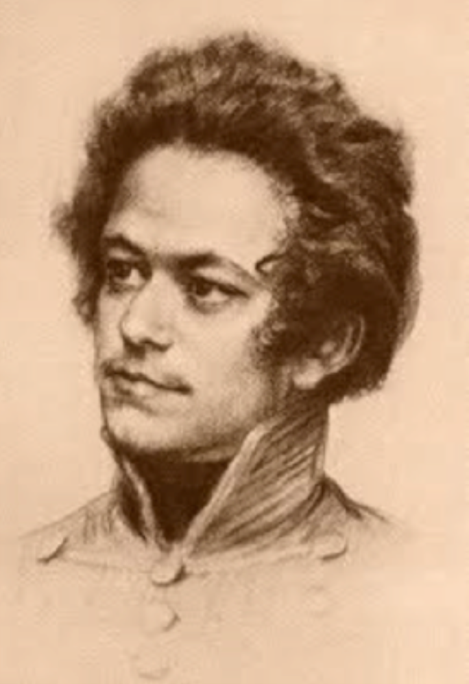
Where Marx Went Wrong
The business class had created a most revolutionary age:
Bringing accumulation, productivity, and wealth to the world
But they could not distribute it equitably
Hence the moral necessity of socialism
And, since the arc of the universe bends toward justice because only the rational can be truly real…
…socialism would come
That was Marx’s fervent belief
He put himself under a geas to demonstrate how it would—must—happen
But ever-increasing degrees of immiserization simply did not happen
Inequality rose to 1900, but the upward leap in economic growth meant that wages rose rapidly after 1870—and inequality began to fall after 1900
4:00 of audio in this slide
Notes:
Karl Marx mocked the sober businessmen of his time who claimed to view revolution with horror, for they were themselves, in a sense, the most ruthless revolutionaries the world had ever seen. The business class of entrepreneurs and investors, together with the market economy that pitted individual businessmen against each other through competition, was responsible for this greatest of all revolutions in the potential human condition: the industrial revolution.
But Marx also saw an overpowering danger: the economic system that the bourgeoisie had created would inevitably soon become the main obstacle to happiness. It could, Marx thought, create wealth, but it could not distribute wealth evenly. Alongside prosperity would inevitably come increasing polarization of wealth. The rich would become richer. The poor would become poorer, kept in a poverty made all the more hateful because needless.
And then would come the revolution. The revolution had—in the sense of a moral requirement—to come. And, because in the long run everything that does not make sense, that is not rational, must be evanescent, not permanently real, the revolution had—in the sense of solid empirical necessity—to come.
Marx put himself under a geas to demonstrate how socialism would—msut-—come. He spent his entire life trying and failing to make his argument simple, comprehensible, and water-tight. He failed. He failed because he was wrong.
It is simply not the case that market economies necessarily produce ever-rising inequality and ever-increasing immiserization in the company of ever-increasing wealth. Sometimes they do. Sometimes they do not. And whether they do or do not is within the control of the government, which has sufficiently powerful tools to narrow and widen the income and wealth distribution to fit its purposes.
Marx, however, thought he had proved that, as long as the existing system was not overthrown by one that nationalized and socialized the means of production:
>The more productive capital grows, the more the division of labor and the application of machinery expands. The more the division of labor and the application of machinery expands, the more competition among the workers expands and the more their wages contract. The forest of uplifted arms demanding work becomes thicker and thicker, while the arms themselves become thinner and thinner…
Fortunately for humanity, Marx further thought, his dystopian vision of what late capitalism would be would not be the end state of human history. The rule of the business class was creating and would create a truly prosperous society because the business class would “produce… above all… its own grave-diggers”.
What would society be like after the revolution? Instead of private property, “individual property based on… cooperation and the possession in common of the land and of the means of production.” And this would happen easily, for socialist revolution would simply require “the expropriation of a few usurpers by the mass of the people”, who would then democratically decide upon a common plan for “extension of factories and instruments of production owned by the State; the bringing into cultivation of waste-lands, and the improvement of the soil generally”.
Now this increasing inequality-increasing immiserization-inevitable socialist revolution simply did not happen. For one thing, while inequality rose to 1900, immiserization did not happen, in Britain at least, beyond 1850. And the upward leap in economic growth after 1870 made working classes all over the globe richer and richer than their predecessors.

Slide 3
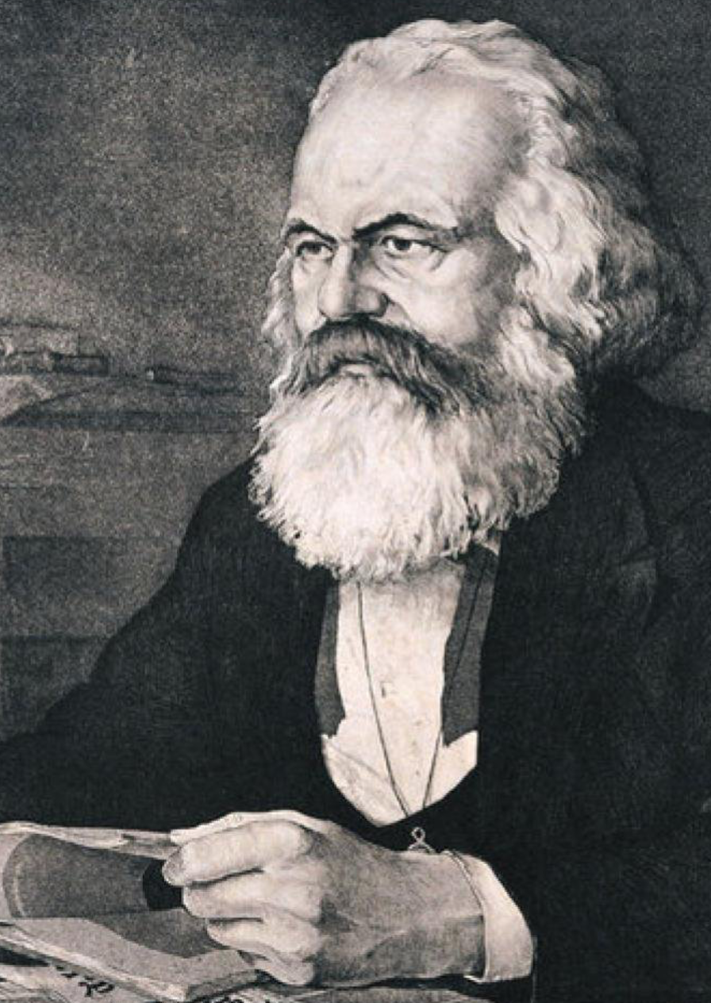
Marx the Prophet
Marx thought he was a moral philosopher:
But his self image was false: he was at least as much a prophet
And his writings became the sacred texts of a revealed religion
Similarities with the Book of the Apocalypse of St. John the Divine
Lenin and company took Marx very seriously: they BELIEVED:
And they tried to build his utopia
Based on the destruction of the market economy as a prerequisite
It was real, it was existing…
…but was what Lenin and his successors built socialism?
Marx would probably have denied that it was…
2:45 of audio in this slide
Notes:
But if Marx was so wrong, why, then, spill so much ink on hm? Because Marx’s writings became the sacred texts of a Major World Religion.
When immiserization did not come, Some sought to reinterpret Marx as meaning meant to imply that the absolute standard of living of workers falls, but only that relative standards of living would fall—that workers would feel relatively deprived as they gazed on palaces of the rich. But those who hold to such an interpretation have a very hard time facing passages in Marx’s writings like:
>[Economic law] rivets the laborer to capital more ﬁrmly than the wedges of Vulcan did Prometheus to the rock… an accumulation of misery, corresponding with accumulation of capital. Accumulation of wealth at one pole is, therefore, at the same time accumulation of misery, agony of toil, slavery, ignorance, brutality, mental degradation… on the side of the [working] class…
Marx was always, in one of his modes, a prophet: someone who had eaten the magic mushrooms found on the island of Patmos. It is hard to read the purpler passages of Marx without being reminded of the Apocalypse of St. John the Divine, and of the Great Voice saying:
>I shall wipe away all tears from their eyes; and there shall be no more death, neither sorrow, nor crying, neither shall there be any more pain: for the former I shall wipe away all tears from their eyes; and there shall be no more death, neither sorrow, nor crying, neither shall there be any more pain: for the former things are passed away…
Socialism was supposed to be Heaven: the New Jerusalem brought down to earth.
Lenin and his successors over 1917-1990 took the doctrines of Marx the prophet seriously. And they tried to make them real. But they were not gods: while they said “let there be true socialism”, what they made was, instead, really existing socialism. It was socialism in that it claimed to be as close as there was or could be to Marx's and other socialists’ of the 1800s hopes. It was existing in that it was there, on the ground, in régimes that at their peak ruled perhaps one-third of the world’s population. It was real in that it was not an intellectual utopian fantasy or a dream, but rather a necessary compromise with the messiness of this world that its propagandists and apparatchiks claimed was as close as possible to utopia.
It is now gone. Throughout most of really existing socialism’s career, Marx would probably have regarded most of it with the dismay and perhaps disdain that St. Paul would have felt for some of those claiming to be his disciples: those who claim that as long as you have accepted Jesus Christ as your personal savior in your heart, it is unimportant whether you feed your hungry, nurse your sick, or visited your imprisoned neighbors.

Slide 4
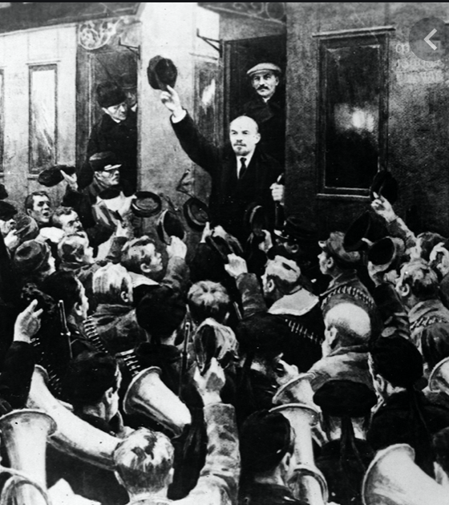
Forming Lenin’s Régime
How did Lenin win the Russian Civil War?:
Lenin’s was a small party staging a coup
How did it survive to rule Russia?
The Czar was overthrown… & a Constituent Assembly elected…
But those who believed in constitutions, process, and democracy are not ruthless
Lenin had:
Trotsky to organize the Red Army
Peasants who hated the Whites
Feliks Dzerzhinsky to organize the secret police
A lot luck
Still, it is remarkable
A counterexample to the belief that successful political movements represent powerful forces in society
An example of contingency in history
An example of the power of modern states—and their data files, and their police
4:00 of audio in this slide
Notes:
Russia’s educated classes were in close cultural contact with western Europe: only one of the first 68 words of Tolstoy’s novel War and Peace is Russian—pomest’ya, a feudal estate governed by the rules of lordship and vassalage rather than private property. The other 67 words are French.
Ideas about equality before the law, governments deriving their just powers from the consent of the governed, meritocracy and the end of caste-status privileges, and constitutions had been flowing into Russia through the window on the West that was the Czar Peter the Great-built Baltic Sea port capital of St. Petersburg for centuries.
In February 1917 the Czar, without supporters, fell. In December Lenin dissolved constituent assembly that was to write a democratic constitution. Then, as British historian Eric Hobsbawm has written:
>as Lenin recognized... all it had going for it was the fact that it was... the established government of the country. It had nothing else.
For a government to survive when there are no powerful social classes or interest groups that have ideological allegiances or substantive reasons to back it requires great ruthlessness.
A brutal Civil War followed. “White” supporters of the Czar, local autocrats seeking effective independence, Lenin’s “Red” followers, stray other forces—including a Czech army of ex-prisoners-of-war that found itself effective ruler of Siberia for a while, plus Japanese regiments—fought back and forth over much of Russia for three years. The Communist government needed to draw on the skills of the old Czarist army officers. But could they be trusted? Leon Trotsky, Commissar for War, came up with the answer: draft the officers, and shadow each one with an ideologically-pure political commissar, who needed to sign each order and would indoctrinate the soldiers in socialism.
Lenin and the Communists won the Civil War, in part because of Trotsky's skill at organizing the Red Army, in part because although the peasants hated the Reds (who confiscated their grain), they hated the Whites who would bring back the landlords even more, and in part because of Feliks Dzerzhinsky's skill at organizing the secret police.
During the Civil War the Communist Party acquired the habit of great ruthlessness that was in the end exercised not only against society outside the Communist Party but against the activists of the Communist Party itself. A “command economy” turned out to require a “command polity” as well.
We are now back at the stage where not structures and processes but rather the characters of individual people matter—that with people of different character at different key positions, the world today might be very different than the world we live in.
We can gain at least some insight into Lenin’s character from a short monolog that the writer Maxim Gorky reported, of Lenin as a classical music critic:
>I know nothing that is greater than the Appassionata [by Beethoven]; I'd like to listen to it every day [Lenin said]…. What marvelous things human beings can do! But… music… makes you want to say stupid nice things, and stroke the heads of people who could create such beauty while living in this vile hell. And now you must not stroke anyone's head: you might get your hand bitten off. You have to strike them on the head, without any mercy, although our ideal is not to use force against anyone. Hm, hm, our duty is infernally hard.”
Perhaps ten million out of the 165 million people in the Russian Empire died in the Russian Civil War: perhaps one million “Red” soldiers, perhaps two million “White” soldiers, plus perhaps seven million civilians. These casualties were on top of the perhaps seven million dead of the Spanish Flu, two million dead in World War I, and 100,000 dead in the Russo-Polish War. By 1921 Russian levels of prosperity had fallen by two-thirds, industrial production was down by four-fifths, and life expectancy was down to twenty.
It was against that background that Lenin and his régime sought to rebuild Russia and build really-existing socialism

Slide 5
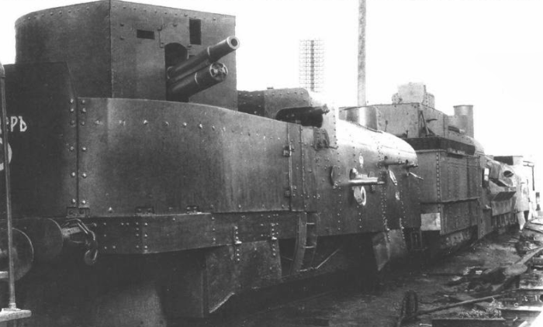
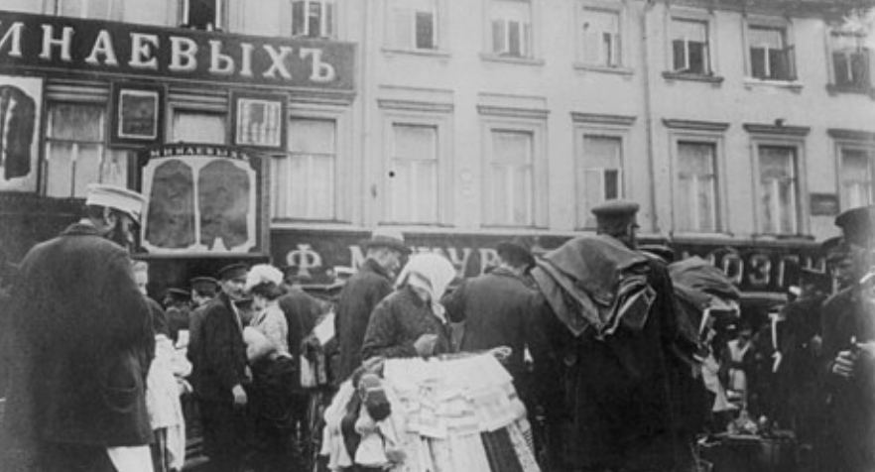
War Communism & New Economic Policy
Lenin’s cadre had never run anything but a newspaper
“War Communism”—attempting to run the country as a military hierarchy
Nationalization of industry
Conflicts with the peasantry
Step back to private property and market exchange with the “New Economic Policy”
By 1927 the Soviet Union was back in 1914
In life expectancy
In industrialization
And without the deadweight of the Czarist aristocracy
Hence life was considerably better for the non-aristocrats
A popular regime
2:15 of audio in this slide
Notes:
Really existing socialism at the end of World War I thus found itself under the leadership of Vladimir Lenin and confined to one country—albeit a very large country—and to a very poor country, in which few had ever imagined socialism might be attempted: Russia.
How could the relatively small group of socialist agitators that had gathered under Lenin’s banner run a country and build a utopia, when none of them had ever done anything other than organize political rallies and write propaganda?
Lenin attempted “War Communism”: military mobilization of the economy along the lines he saw in World War I Germany.
The first step was nationalization: all factories, credit institutions, and international trading organizations were nationalized. All wages were equalized. Instead of employers hiring workers, party functionaries conscripted them. In agriculture War Communism was a disaster—the ﬁrst of many agricultural disasters. The do-it-yourself redistribution of land that the peasants accomplished and the Bolshevik Party blessed was very popular. But the government needed food for the towns. The government tried to requisition food. The peasants hid the grain. Urban workers, hungry, returned to their relatives’ family farms, where they could get fed.
Yet War Communism managed to produce and control enough resources—and the Leon Trotsky-led Red Army managed to find enough weapons and win enough battles—that the Bolsheviks won the Russian Civil War.
Lenin stepped back to the “New Economic Policy”, letting prices rise and fall, letting people buy and sell and get richer, requiring that managers of government factories make profits or be sacked, letting a class of merchants and middlemen grow as “tolerated outlaws” as Keynes put it.
By 1927 the new Soviet Union was back—in life expectancy, in population, in industrial production, in standards of living—to what it had been in 1914. And there was no longer the deadweight of the Czarist aristocracy consuming resources and keeping the country down. As long as Lenin’s successors could avoid destroying the country through their own mistakes, and as long as they could keep the baseline to which people compared them at the privations and chaos of war, plague, and civil war, it would be hard for them to be very unpopular.
And Lenin’s successors could take the next steps.

Slide 6
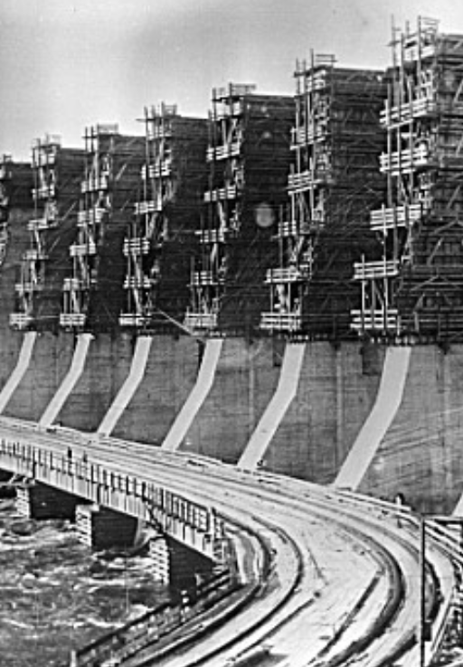
How Could the System Work?
How do you run a planned economy?
Control a few hundred key commodities and their flows through material balances
Impose semi-military discipline
Make the rest of it factory managers’ problems
Hence they have to beg, borrow, buy, barter, and steal resources other than those tracked by material balances
Highly inefficient, highly corrupt
Exchange, barter, blat, and plan—understood as a desire to accomplish the organization’s primary goals—in a mixture
Note that this is not that different from the internal workings of a capitalist corporation in a market economy
The big difference is that efficiency is incentivized because a capitalist firm is always facing the make-or-buy decision
And a capitalist firm has a hard budget constraint: input and output prices govern its decisions
Thus really-existing socialism mammothly inefficient
4:15 of audio in this slide
Notes:
How do you run industry and economic life? Like an army: top down, planned, hierarchical, with undermanagers promoted, fired, or shot depending on how well they attained the missions that the high economic command had assigned them. Lenin had been impressed by what he saw of the German centrally-directed war economy of World War I:
>The war has reaffirmed... that modern capitalist society... has fully matured for the transition to socialism. If... Germany can direct the economic life of 66 million people from a single, central institution... then the same can be done... by the nonpropertied masses if their struggle is directed by the class-conscious workers.... Expropriate the banks and... carry out in [the masses’] interests the same thing the [wartime] Weapons and Ammunition Supply Department is carrying out in Germany…“
But how did this work, exactly? Walther Rathenau, his advisor Wichard von Moellendorff, and their colleagues in the Prussian War Ministry’s Raw Materials Section had started by increasing government demand for war materiel while imposing price controls: we will pay you what we offered last month, but no more. But then materials that the government wanted to buy began to be diverted to the civilian economy. So the World War I-running governments prohibited the use of “strategic” materials for non-priority uses.
They began keeping track of material balances for a very few key commodities: matching production capabilities to uses, with the money flows for purchases becoming simply an accounting device.
War expenditures rose from one-sixth of national income to two-thirds. The government began planning and commanding not just the movement of key raw materials to and through the factories and then finished products off to the front, but that factories be expanded and built to provide for additional war production.
This worked, sort of, in the Soviet Union too.
A hundred key commodities were controlled by material balances from the center, demands were issued to factory managers from the center, and the factory managers then had to make do—beg, borrow, barter, buy, and steal the resources over and above those directed to them by material balances in order to fulfill as much of the plan as possible.
It was highly inefficient. It was highly corrupt.
It did focus attention on producing those commodities on which the center placed the highest priority and to which, via material balances, it devoted the key resources. Non-key commodities were exchanged between businesses and out to users either through standard market cash-on-the-barrelhead transactions or via blat: connections: “the use of personal influence for obtaining certain favors for which a firm or individual is not legally or formally entitled”. Plus the tolkach. Tolkachi would find out who had the goods you needed, and what goods you might be able to acquire those who had the goods you needed might value. They were barter agents. In 1930, only two years after the turn away from the NEP there were already more than 2500 tolkachi hard at work in Moscow alone.
One not-so-hidden secret of capitalist business is that most companies’ internal organizations are a lot like the crude material balance calculations of the Soviet planners. Inside the firm, commodities and time are allocated by swapping favors, by noting bosses’ high priorities and trying to accomplish them, by social engineering and arm-twisting, by digging into their own pockets for incidentals. Market, barter, blat, and plan understood as the organization’s primary purposes always rule—with the market confined to the external interfaces of most organizations.
The difference is that a standard business firm is embedded in a much larger market economy, and so is always facing the make-or-buy decision. That keeps businesses in capitalist market economies on their toes, and more efficient.
That was absent in the Soviet Union. Hence its economy was grossly wasteful.

